Slide 1
COVID-19 forecasting using Machine Learning
Team members:
Srikanth Kareedu 121014049
Sai Ram Vundavalli 121014057
Gollapalli Surya Sagar 121014059
B.Tech 4th Year ICT
Project guide:
PREMALADHA J, ICT
SoC, SASTRA University

Slide 2
Contents
Base Paper details
Problem statement
Introduction
Literature Survey
Objective
Workflow
Dataset details
Methodologies
Algorithms
Implementation Steps
Sample Output
Visualization Of Output
Scope Of Development
Conclusion
Division Of Responsibilities
Skip To Workflow

Slide 3
Base paper details
Title: COVID-19 Future Forecasting Using Supervised Machine Learning Models.
Published in: IEEE Access
Date: 2020 May 25
DOI: 10.1109/ACCESS.2020.2997311
Authors: Rustam F, Reshi AA, Mehmood A, Ullah S, On B, Aslam W, Choi GS.
https://ieeexplore.ieee.org/stamp/stamp.jsp?tp=&arnumber=9099302

Slide 4
Problem Statement
What will be the extent of spread of the Coronavirus?
How many people can be affected by it?
What would be the future course of actions to reduce its spread?

Slide 5
Introduction
Underestimating or overestimating can lead to catastrophic consequences
Forecasting allows us to understand the situation better
Analysis of the trajectory of confirmed ,recovered cases and number of deaths using the following:
Linear regression (LR),
Least absolute shrinkage and selection operator (LASSO)
Support vector machine (SVM)
Exponential smoothing (ES)
Notes:
Overestimation: This was the case with SARS when governments persuaded on the severity of the virus bought large numbers of vaccines that were never used as its spread stopped without the need to vaccinate people.
Underestimation: 1918 Spanish flu that killed an estimated 50 million worldwide.
Then we didn’t have the tools of course…but now we have a magic trick called ml

Slide 6
Literature Survey
S.NO | TITLE & AUTHORS | Published In | YEAR | TECHNIQUES | PERFORMANCE EVALUTAION
1 | Predicting the growth and trend of COVID-19 pandemic using machine learning and cloud computing Shreshth Tuli, ShikharTuli, RakeshTuli & Sukhpal Singh Gill | Science Direct | 12 May 2020 | Robust Weibull Model | MSE: 2.41E+07

Slide 7
Literature Survey (Continued…)
S.NO | TITLE & AUTHORS | Published In | YEAR | TECHNIQUES | PERFORMANCE EVALUTAION
2 | A python based support vector regression model for prediction of COVID19 cases in India DebanjanParbat MonishaChakraborty | Science Direct | September 2020 | SVM | (In next slide)

Slide 8
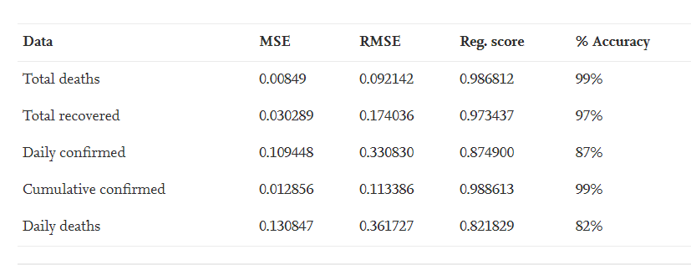
Literature Survey (Continued…)
A python based support vector regression model for prediction of COVID19 cases in India

Slide 9
Objective
The main objective of this project is to develop a forecaster that helps in decision making for containing the spread by predicting the following
• No. of newly confirmed cases
• No. of new death cases
• No. of people recovered

Slide 10

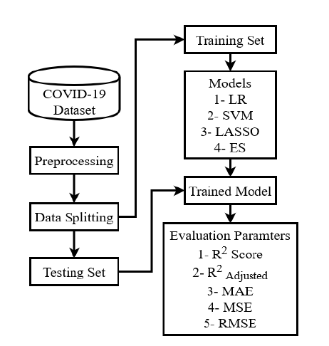
Linear regression (LR)
Least absolute shrinkage and selection operator (LASSO)
Support vector machine (SVM)
Exponential smoothing (ES)
Workflow Of The Forecaster
MSE-Mean Square Error
MAE-Mean Absolute Error
Skip to Implementation

Slide 11
Dataset
Repository for the 2019 Novel Coronavirus Visual Dashboard
Johns Hopkins University Center for Systems Science and Engineering (JHU CSSE)
Consists of time-series datasets (From January 22, 2020)
3 timeseries datasets - confirmed, recovered and death cases recorded globally
Click here for dataset
Notes:
Univariate time series: Only one variable is varying over time. For example, data collected from a sensor measuring the temperature of a room every second. Therefore, each second, you will only have a one-dimensional value, which is the temperature.

Slide 12
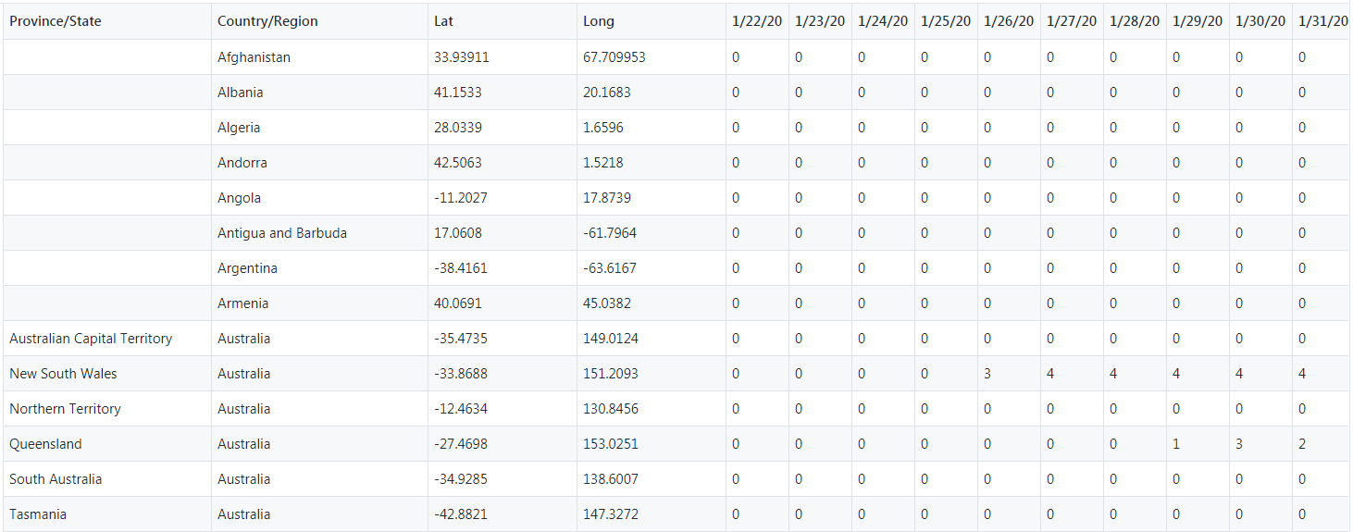
Dataset-Samples: 1- Confirmed Cases

Slide 13
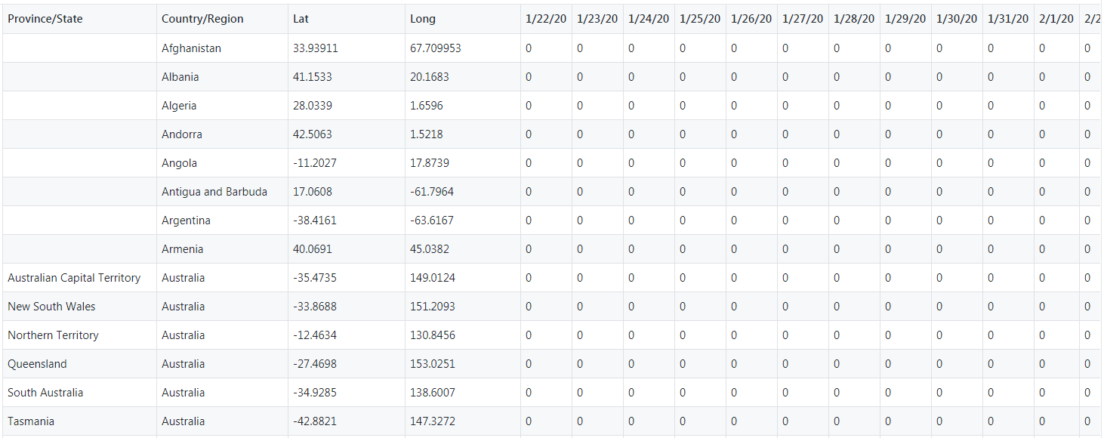
Dataset-Samples: 2-Number of Deaths_

Slide 14
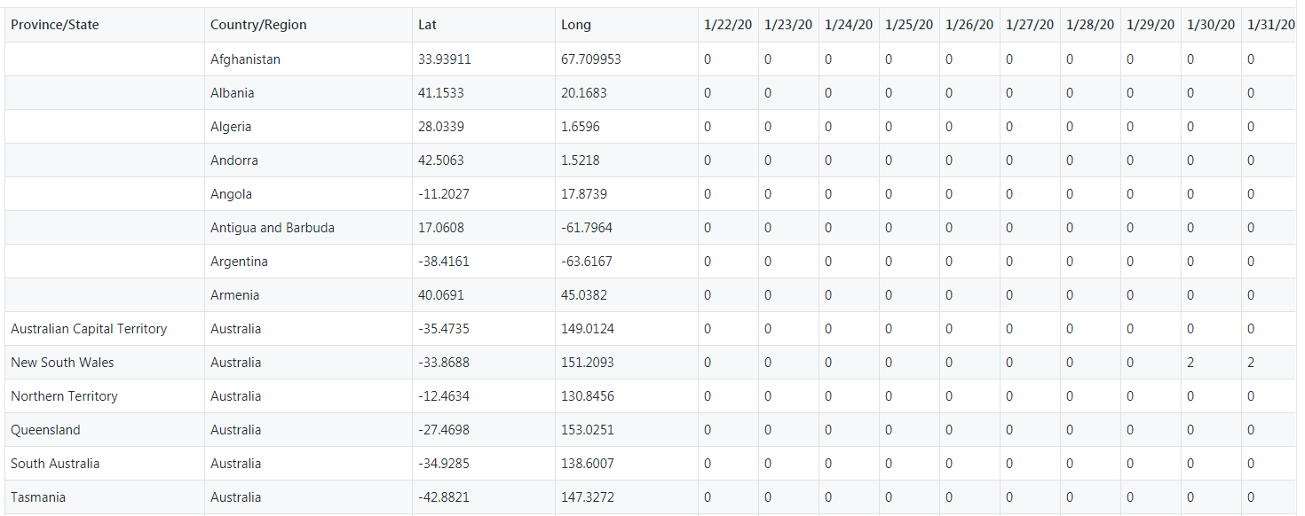
Dataset-Samples: 3-Number of recoveries

Slide 15
Methodologies
Linear regression (LR)
Least absolute shrinkage and selection operator (LASSO)
Support vector regression(SVR)
Exponential smoothing (ES)

Slide 16
Algorithm-Linear Regression
In this model the machine is trained on set of input data whose output is also predefined
The model is expected to predict the output for newly unseen data input
Each observation in this model is dependent on two values dependent variable and an independent variable.

Slide 17
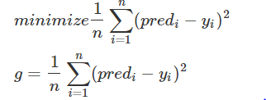
Algorithm
Equation
y = β0 + β1x + ε
E(y) = β0 + β1x
Cost Function
Here, ε is the error term of linear regression.
x – input data set Y – output/class labels
Notes:
In SVM we try to find the maximum marign ie the deciasion boundary or hyperplane that can give the maximum distance between two support vectors(the closest points to the hyperplane)
Kernels are used to transform datapoints from one mathematical space to another.
Kernels come into play especially when converting non-linearly spearable data to linearly separabale data
By using kernals we van create a linear decision boundarry even for non linear datapoints whichout chaging their interrelationshiop
In Support Vector Regression, we are trying to fit a decision boundary that is some distance away from the hyperplane such that the data points closest to the hyperplane or support vectors are within that boundary line.

Slide 18
Algorithm- SVR
It is supervised technique used for regression.
SVM solves the regression problems using a linear function.
For problems of non-linear regression, it maps the input vector(x ) to n -dimensional space called a feature space (z ) using Kernel.
And then Linear regression is applied to space.

Slide 19
Algorithm
For multivariate training dataset (X_{n}) with N number of observations and with (y_{n}) as a set of observed responses.
The linear function can be depicted as: f(x)=x′β+b
The above function is reduced to find f(x) such that we minimize the cost of (ββ')
J(β)=½(ββ')

Slide 20
LASSO
This is a regression technique which uses shrinkage.
It shrinks the extreme values of data sample towards central values.
It sets the features that cannot help the regression to very small value 0
Thus the models are made sparse with few coefficients in this case of regularization since the process eliminates the coefficients when their values are equal to zero.

Slide 21

Algorithm
Minimize the following
It sets the coefficient, which can be interpreted as min(sum of square residuals +λ times the slope), where, λ is penalty term

Slide 22
Exponential smoothing(ES)
In this method, forecasting is done based on previous periods’ data.
The past data observations’ influence is decays exponentially as they become older.
ES is a very simple powerful time series forecasting method specifically for univariate data .

Slide 23

Simple Exponential Smoothing (Proposed Techniques)
Time series forecasting method for univariate data without a trend or seasonality
Alpha (a), also called the smoothing factor (0-1)
A value close to 1 indicates fast learning (most recent values influence the forecasts)
A value close to 0 indicates slow learning
The forecast for the current time

Slide 24
Double Exponential Smoothing (Holt’s linear trend model)
Explicitly adds support for trends in the univariate time series.
Additional smoothing factor is added to control the decay of the influence of the change in trend called beta (b).
Small β - Trend changes only very slowly over time
Large β - Changing more rapidly

Slide 25
Double Exponential Smoothing (Continued)
Continuously revising a prediction after taking into account the more recent observations.
Exponentially diminish the older observations’ importance for forecasting by decreasing their weights.
More recent observations matter more than older ones
Notes:
Phi- to prevent the forecast “go wild”

Slide 26
Algorithm for DES
Import Holt from statsmodels.tsa.api
Use Holt function to build the model
Fit the model- Specify Smoothing Level, Smoothing Slope
Make Forecast
Notes:
First, an instance of the ExponentialSmoothing class must be instantiated, specifying both the training data and some configuration for the model.
Specifically, you must specify the following configuration parameters:
trend: The type of trend component, as either “add” for additive or “mul” for multiplicative. Modeling the trend can be disabled by setting it to None.
damped: Whether or not the trend component should be damped, either True or False.
seasonal: The type of seasonal component, as either “add” for additive or “mul” for multiplicative. Modeling the seasonal component can be disabled by setting it to None.
seasonal_periods: The number of time steps in a seasonal period, e.g. 12 for 12 months in a yearly seasonal structure (more here).
The model can then be fit on the training data by calling the fit() function.
This function allows you to either specify the smoothing coefficients of the exponential smoothing model or have them optimized. By default, they are optimized (e.g. optimized=True). These coefficients include:
smoothing_level (alpha): the smoothing coefficient for the level.
smoothing_slope (beta): the smoothing coefficient for the trend.
smoothing_seasonal (gamma): the smoothing coefficient for the seasonal component.
damping_slope (phi): the coefficient for the damped trend.
Additionally, the fit function can perform basic data preparation prior to modeling; specifically:
use_boxcox: Whether or not to perform a power transform of the series (True/False) or specify the lambda for the transform.
The fit() function will return an instance of the HoltWintersResults class that contains the learned coefficients. The forecast() or the predict() function on the result object can be called to make a forecast.

Slide 27
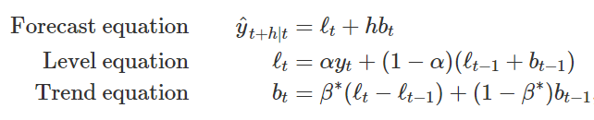
Exponential Smoothing- Formula
Symbol | Definition
ℓt | Level Estimate
bt | Trend/Slope Estimate
α | Level smoothing parameter
β∗ | Slope Smoothing Parameter

Slide 28
Implementation steps
The data sets have been extracted from the Git Hub repository
Dataset is analyzed and unnecessary data is removed
The dataset is normalized by using rolling mean
The dataset is split into two sets namely, 1. Training set- 90% of the total dataset 2. Testing set- 10% of the total dataset
Number of cases, deaths and recoveries are extracted
Return to WorkFlow

Slide 29
Implementation steps
The Training set has been used to train different regression models
The models are tested on Testing set
The model's performance is evaluated using MSE and MAE
The outputs of all model are visualized
Skip to visualization

Slide 30
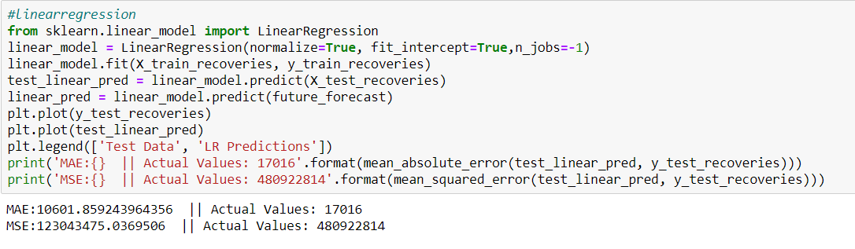
Output Forecasting recoveries using Linear Regression
Using function to prepare the model
Test_linear_pred makes prediction based on the X_test
From Day 1 to Day 56
Forecast for all the days
From Day1 to the Day 73(last)
Observation:
The observed errors are within the predicted errors
Dataset is split using Shuffle=True

Slide 31
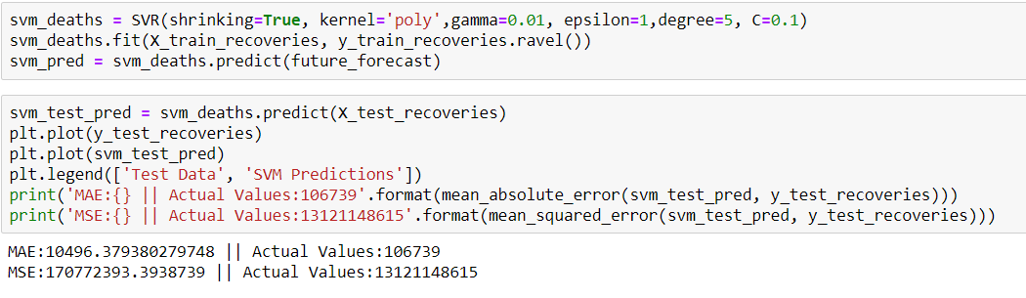
Output Forecasting recoveries using SVM

Slide 32
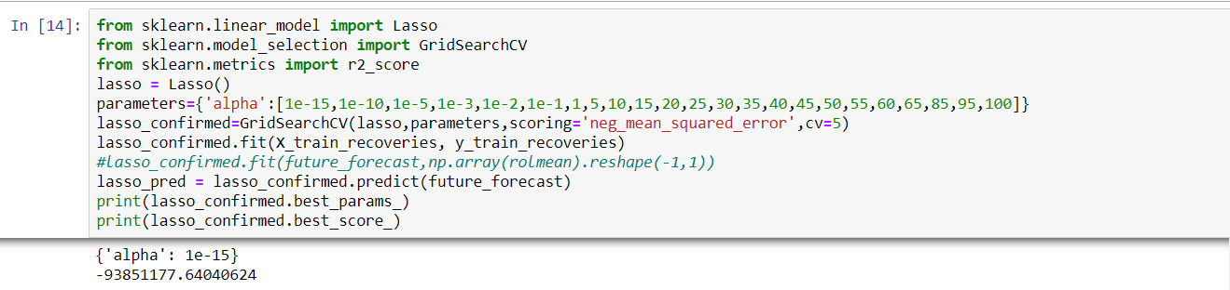
Output Forecasting recoveries using LASSO

Slide 33
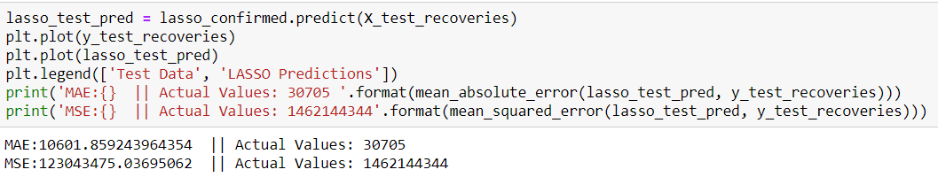
Output Forecasting recoveries using LASSO

Slide 34
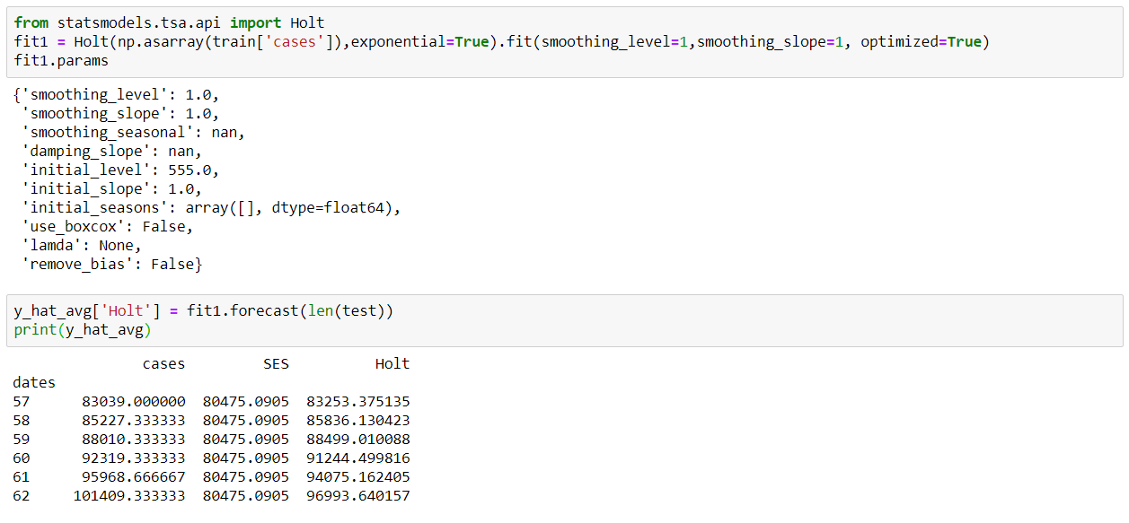
Output Forecasting Recoveries using ES
Using Exponential Smoothing(HOLTS)
Fast Learning Giving importance to recent observations
Smoothing_level=1 and smoothing_slope=1 gave the best fit

Slide 35
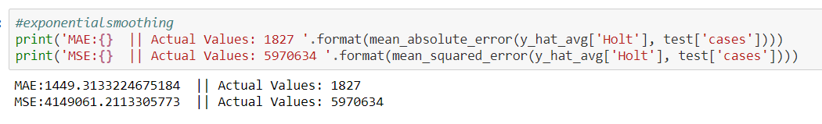
Output Forecasting Recoveries using ES
Observation:
The predicted errors are within the actual errors

Slide 36
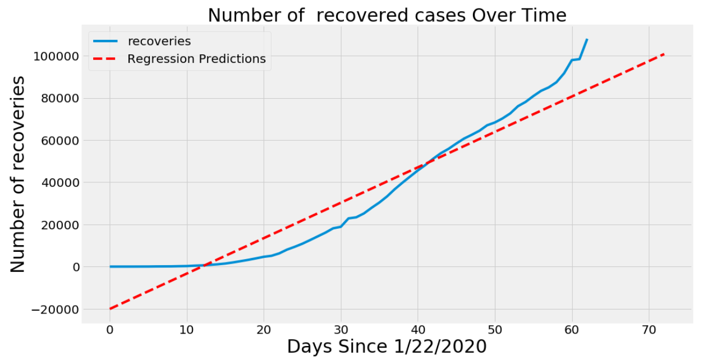
Output Visualization (Linear Regression)

Slide 37
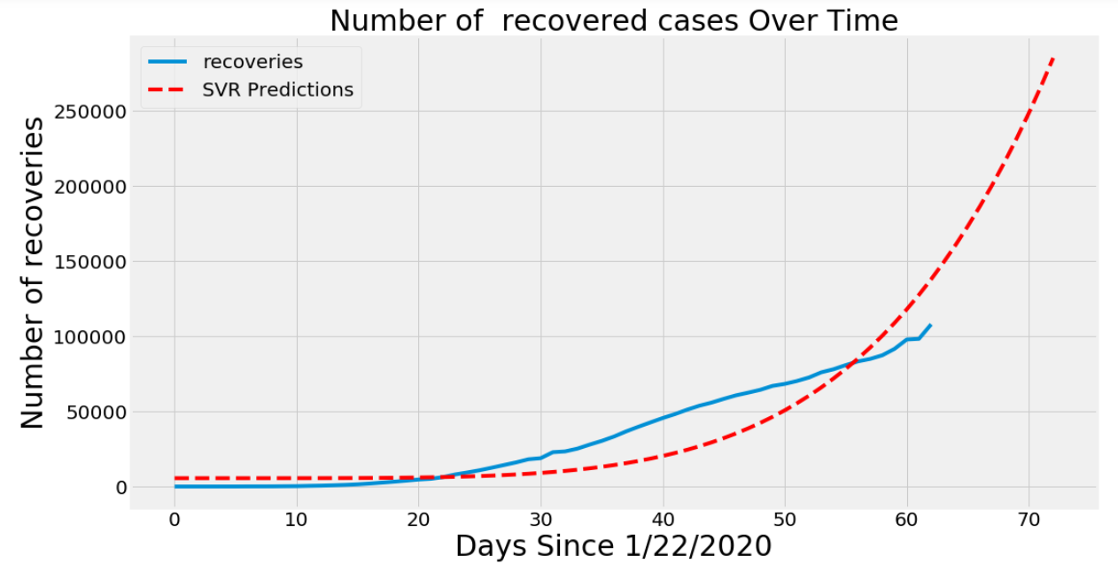
Output Visualization (SVR)
Observations:
The difference is reduced
Performs better than LR

Slide 38
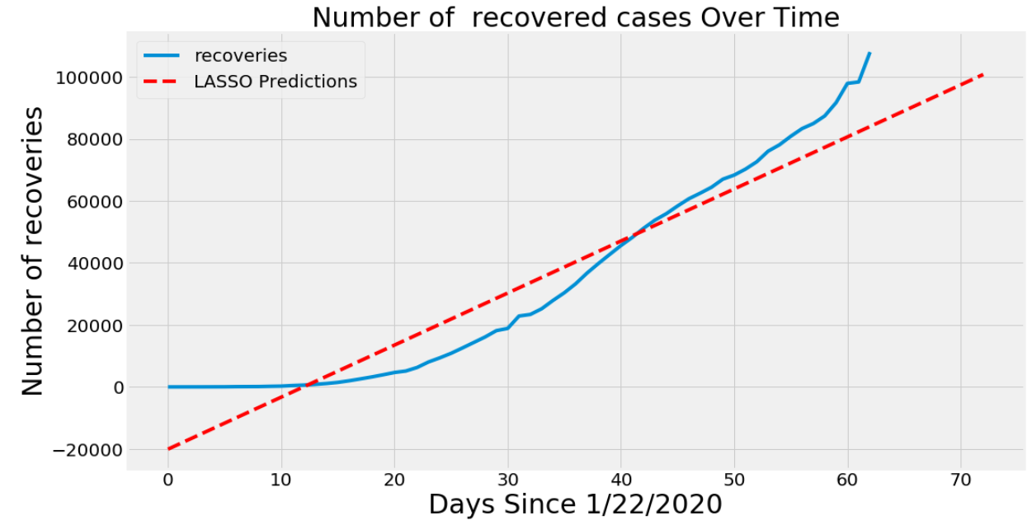
Output Visualization (LASSO)
Observations:
Similar to LR

Slide 39
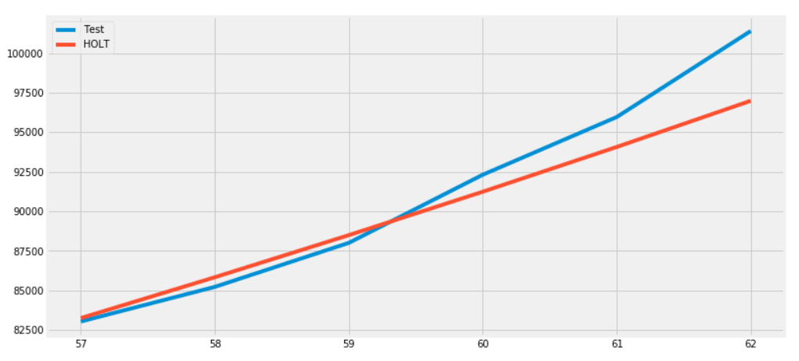
Output Visualization (Exponential Smoothing)
Observations:
Provides the best fit
Best suited since ES works well on exponential data

Slide 40


Results
MAE
LR:
10601
LASSO:
10601
ES:
1449.31
SVM:
10496
The number of confirmed cases will increase exponentially
Number of Deaths will also increase
It also promises steady increase in recoveries.
Most models performed as per the results in base paper
ES performed the best among all the models
SVM is the next best

Slide 41
Scope of development
To incorporate new models like Robust Weibul Model into our project
Finding the spread of new strains of the virus
To forecast other variables like, end date of lockdown in various countries

Slide 42
Conclusion
The uncertainty surrounding an unknown, novel coronavirus can spark a global alarm
Forecasts and their associated uncertainty can and should be an integral part of the decision-making process, especially in high risk cases.
Thank You!

Slide 43
Division Of Responsibilities
Surya Sagar: Learnt and Applied ES
Performed preprocessing and normalization
Srikanth: Learnt and applied LASSO and SVR
Removed redundant attributes
Sai Ram: Learnt and applied LR and SVR
Replicated and optimized results in forecasting Deaths and Recoveries

